Slide 1
AMATEUR RADIO · DIGITAL MODES
The DigiPi
Radio Interface
A Raspberry Pi hotspot that puts FT8, Winlink, APRS, packet,
and the rest of the data modes on any of your devices.
Presentation by N1TXN

Slide 2
WHAT IT IS
A data transceiver you run from a browser
DigiPi is an open-source Raspberry Pi image. Flash a card, plug in a radio interface, and every major data mode is available over Wi-Fi — no monitor, keyboard, or laptop on the desk.
01
02
Hotspot, not a desktop necessarily
One image, many modes
The Pi boots as its own Wi-Fi network. Phone, tablet, or laptop is the control head.
WSJT-X, JS8Call, fldigi, Pat/Winlink, Direwolf, SSTV, and AX.25 node services live on the same card.
03
04
Built for the field
License required
Low power and small enough for POTA, SOTA, and go-kits. A Pi 3A+ is the suggested base rig, just don’t use old single core pi
It transmits. A current amateur license and normal band privileges still apply.
DIGIPI
2 / 12

Slide 3
HOW THE INTERFACE WORKS
Audio, PTT, and optional CAT
The radio interface is the piece between the rig and the Pi. It carries receive audio in, transmit audio out, keys the transmitter, and — on CAT radios — sets frequency and mode.
Radio
Raspberry Pi
With DigiPi image
Wi-Fi
Mic, speaker,
and PTT line
Interface
Modern radio like 991A,7300
Or
NA6D board
Modems and
radio apps
Browser or
phone app
RX audio
TX audio
PTT
CAT
Radio speaker or data jack into the interface ADC. Levels set in the web audio page or alsamixer.
Pi generates the tone. Interface drives the mic or data-in line.
GPIO, CM108/DTR, or CAT. DigiRig Mobile, AIOC, and the NA6D board all key the rig.
Optional serial control. Needed for easy band changes on HF. Skip it on a fixed VHF packet channel.
DIGIPI
3 / 12

Slide 4
TWO WAYS TO CONNECT A RIG
USB radios vs. a classic interface
PATH A
PATH B
Radio already has USB
Classic radio or HT
Modern HF and some VHF rigs expose a sound card and CAT on one USB cable. The Pi is the computer. No extra interface board.
Anything with a mic/speaker or data jack needs a sound-card interface that can also key PTT.
IC-7300, IC-705, FT-991A, Xiegu
Baofeng / Kenwood two-pin HTs
USB cable matched to the radio
Mobile rigs without USB audio
Select the rig in Initialize
Older HF with a 6-pin data port
Disable NR, notch, and NB on HF
AIOC, Digirig, hat, or NA6D board
Confirm USB audio is AF, not IF
Ferrites. HTs and USB do not like RF.
DIGIPI
4 / 12

Slide 5
SUPPORTED RADIO INTERFACES
Pick the board that matches the jack
Digirig Mobile
USB sound + CAT serial
HF and CAT mobiles. Get Mobile, not Lite — Lite is poorly supported on Pi.
AIOC
USB audio + DTR PTT
Baofeng / Kenwood two-prong. About $25. RF-sensitive; use ferrites and an external antenna.
DigiPi Hat
GPIO hat
elekitsorparts.com, about $40. Stays on the Pi. Good for a dedicated packet box.
NA6D interface
PTT board + sound card
NA6D’s interface: PTT, status LEDs, PS/2 or TRRS. Kit or built.
DRA-Pi-Zero
Masters Communications
Purpose-built Pi Zero digital interface, about $75. Clean PTT and audio.
TOADS / Signalink
USB sound interfaces
Work if the Pi sees the sound card and a PTT method. Signalink is the known quantity.
DIGIPI
5 / 12

Slide 6
THE COMPUTER SIDE
Which Pi, and what else you need
Pi Zero 2 W
Pi 3A+
Pi 4
Pi 5
Smallest go-kit. Fine for packet and APRS. Tight for HDMI and heavier apps.
DigiPi current base suggestion, about $25. Easy to find. Pairs well with a DSI screen.
Comfortable for WSJT-X, JS8, and a display at the same time.
Supported since v1.8. Fastest UI. Overkill for a VHF packet box, nice for an HF shack node.
Power
Display
GPS
A solid 5 V supply. Undervoltage shows up as dropped Wi-Fi and flaky USB audio.
Optional. v2.2 accelerates HDMI and MIPI/DSI. An 800×480 DSI panel is about $35.
Optional USB GPS. Initialize can read ttyACM and fill grid, lat, and lon.
DIGIPI
7 / 12

Slide 7
WHAT YOU CAN ACTUALLY RUN
Modes on the v2.2 image
FT8 / FT4
JS8Call
Winlink
APRS
WSJT-X in the browser. Weak-signal HF and 6 m. v2.x tracks current WSJT-X.
Keyboard-to-keyboard at FT8 SNR. v2.2 adds JS8Call Improved.
Pat webmail. Packet on VHF, ARDOP on HF, Mercury HF modem in v2.2.
WebChat, digipeater on 144.390, IGate, and a Direwolf tactical map.
Packet / AX.25
fldigi
SSTV
Node services
KISS TNC over Wi-Fi or Bluetooth. Xastir, YAAC, APRSdroid, WOAD.
CW, PSK31, RTTY, Olivia, MFSK, Contestia, THOR, and the rest of the suite.
Send and receive images from the phone browser.
Your own BBS or node. NetRom and 44-net style AX.25 networking.
DIGIPI
9 / 12

Slide 8
FIRST BOOT
From a blank card to on the air
1
Get the image
2
Join the hotspot
3
Initialize
Download from digipi.org. Patron-supported project. Flash with Balena Etcher or the Raspberry Pi Imager to a microsd card(8gb min).
SSID DigiPi, password abcdefghij. Browse to http://10.0.0.5. digipi.local also works once it is on your LAN.
Callsign, grid, lat/lon, Winlink and APRS passwords, AX.25 node pass, screen type, and radio interface.
Make sure and know all of the above ahead of time or you will have to reflash image and start over!
4
Home Wi-Fi
5
Levels
6
One card per rig
Point it at the shack network so you are not stuck on the hotspot. Field use stays on the DigiPi SSID.
Set RX and TX in the web audio page. For FT8/JS8, save configs inside the app. Packet is mostly the interface gain.
Never had to do this but good to check if you have issues
Keep a separate SD card per radio. Levels and CAT settings do not travel well between rigs.
DIGIPI
8 / 12

Slide 9
SHACK AND FIELD NOTES
The things that actually bite you
RF into the USB cable
Audio too hot
Wrong PTT method
AIOC and cheap CM108 cards lock up when the HT uses the USB lead as the counterpoise. External antenna, ferrites on the USB lead, and UHF is kinder than VHF.
Start the HT volume near max, then trim in alsamixer. AIOC starting points often cited: input around 70, output around 84. Watch the ALC on HF.
Digirig Mobile uses its serial port. AIOC uses DTR on /dev/ttyACM0. A hat uses GPIO. Pick the interface in Initialize so the image wires the right one.
CAT mismatches
Wi-Fi in the field
One service at a time
Some rigs, including the IC-7000, need a manual rigctld fix. The Initialize page lists connected audio and serial devices so you are not guessing filenames.
Hotspot mode was flaky on earlier images and is solid on Pi 3/4/5 in current builds. Password stays abcdefghij unless you change it.
Do not leave the TNC, WSJT-X, and fldigi all fighting the same sound card. Boot into the mode you came to run.
DIGIPI
10 / 12

Slide 10
A WORKING GO-KIT
Two realistic shopping lists
HF SHACK NODE
VHF GO-KIT
991-A or IC-7300 class rig
HT or mobile, ~$60–90
Pi 4 or Pi 5
already on the bench
Pi 3A+
about $25
USB cable
the one the radio expects
AIOC cable
about $25, Baofeng/Kenwood
Optional DSI or HDMI
~$35 if you want a panel
or Digirig Mobile
if the rig has a data port
DigiPi image
digipi.org
Ferrite beads
a few dollars, not optional
Nothing else
the rig is the interface
External antenna
stops the USB freeze
DIGIPI
11 / 12

Slide 11
WHERE TO GO NEXT
Start with the image.
Then match the jack.
digipi.org
Image, shopping list, howto videos
github.com/craigerl/digipi
Wiki: radios, interfaces, initialize
NA6D.com
Radio Interface Board, kit or built
patreon.com/KM6LYW
Release notes and the current image
A license is required to transmit. Prices are approximate, late 2026.

Slide 12
THE DIGIPI RADIO INTERFACE BOARD
NA6D’s board, built for this image
NA6D designed a prefab interface specifically for DigiPi. It is the ham-made option when the radio does not speak USB.
PTT circuit
Cost
Keys the rig from the Pi without a separate VOX box or a hand on the mic.
Status LEDs
You can see PTT and interface state without opening a terminal.
NA6D board unsoldered $20
or
NA6D board soldered $33 (kenwood style)
Optional:
Solder guide/jig $4
3D printed case $4 (free if you have 3d printer)
Shielded ferrite USBC cable $10 (good to have anyway)
Kenwood style or TRRS
One board, two common radio connectors. Cable the jack you actually have.
Kit or built
Solder the parts kit, or buy it assembled.
DIGIPI
6 / 12

Slide 13
DEMO DigiPi

Slide 14
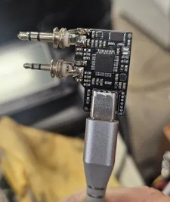
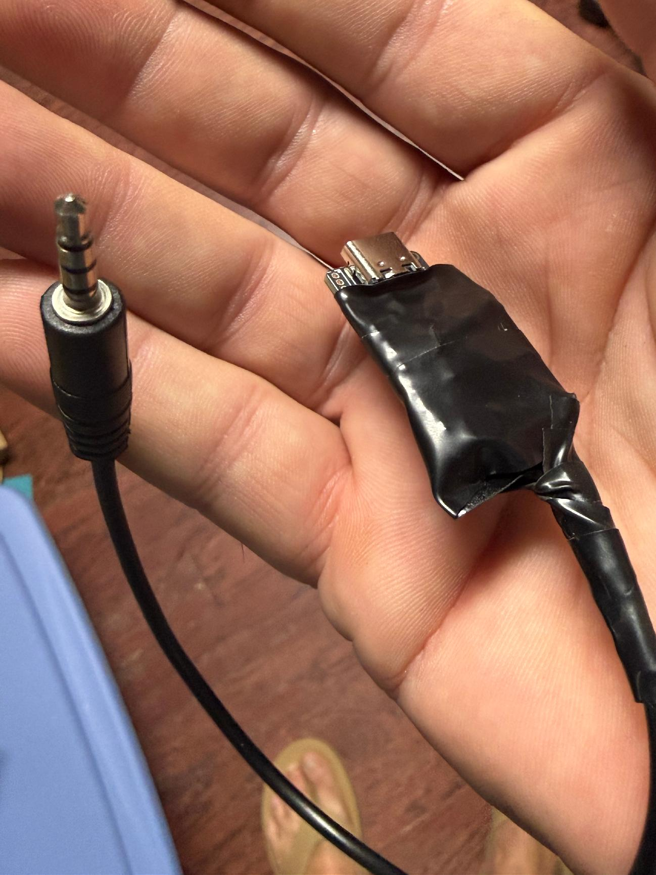
NA6D board options
Kenwood style or Yaesu TRRS
DIGIPI
6 / 12

Slide 15
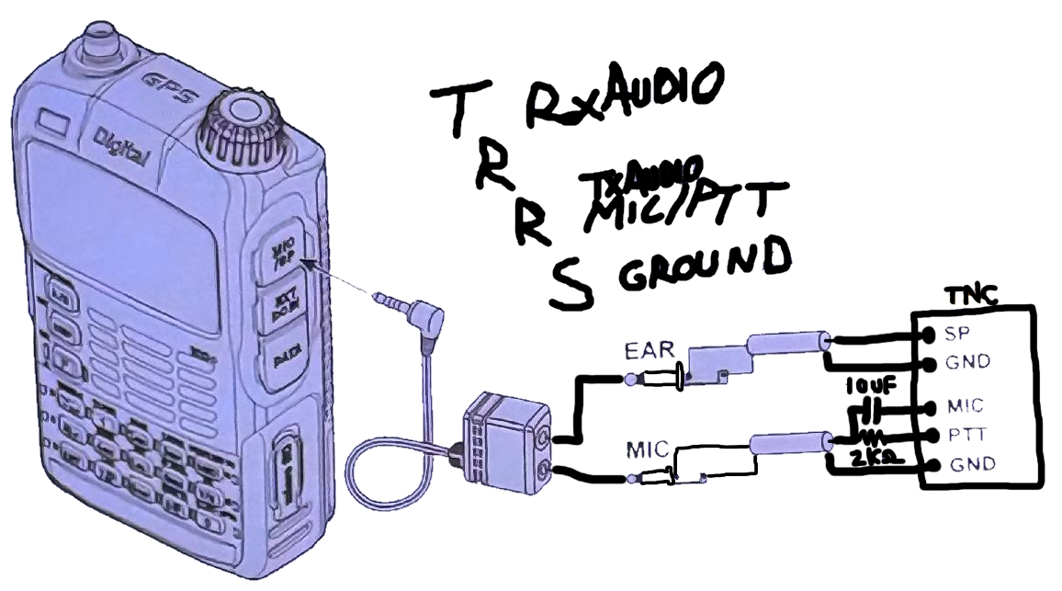


How to make Yaesu TRRS style
Works with FT1-FT5 HT’s
From Yaesu documentation
DIGIPI
6 / 12

Slide 16
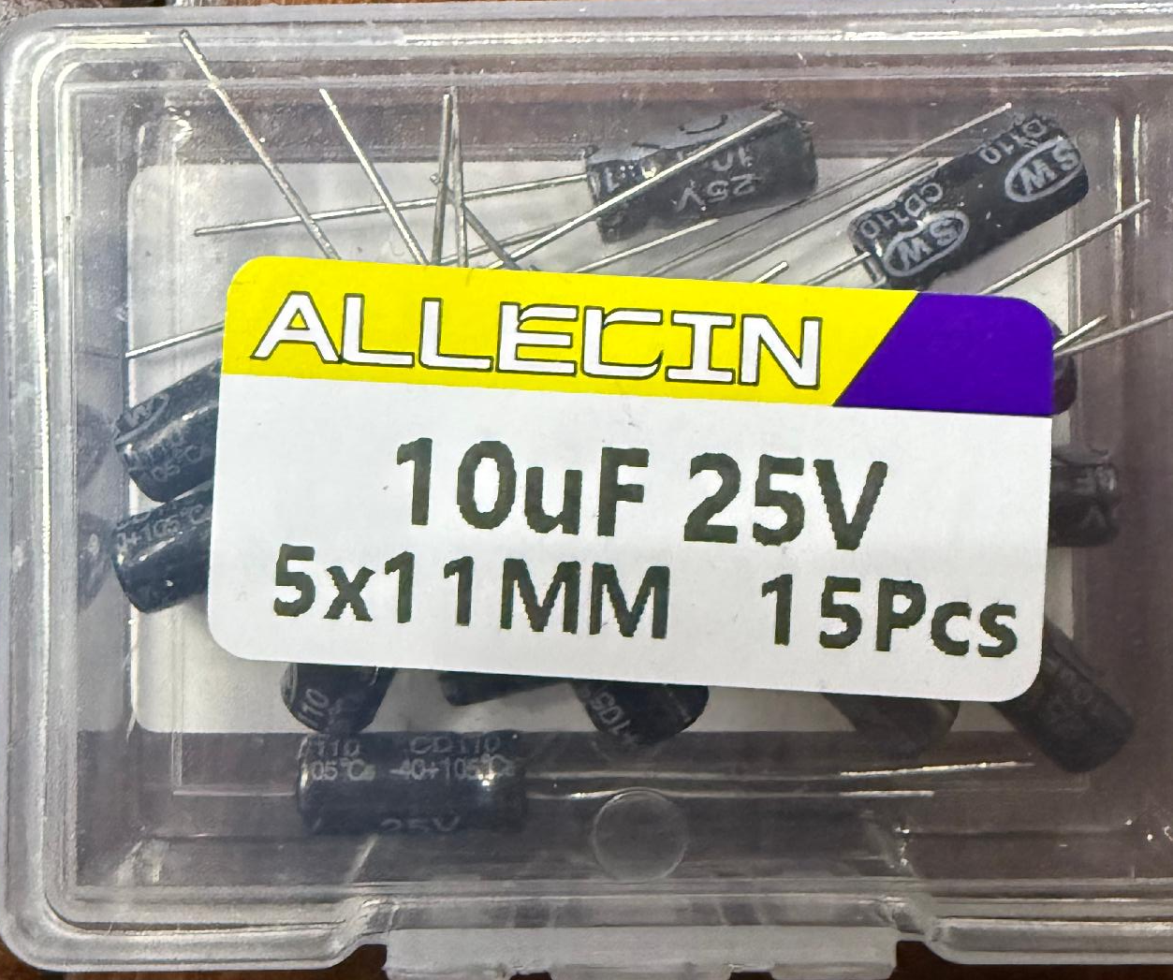
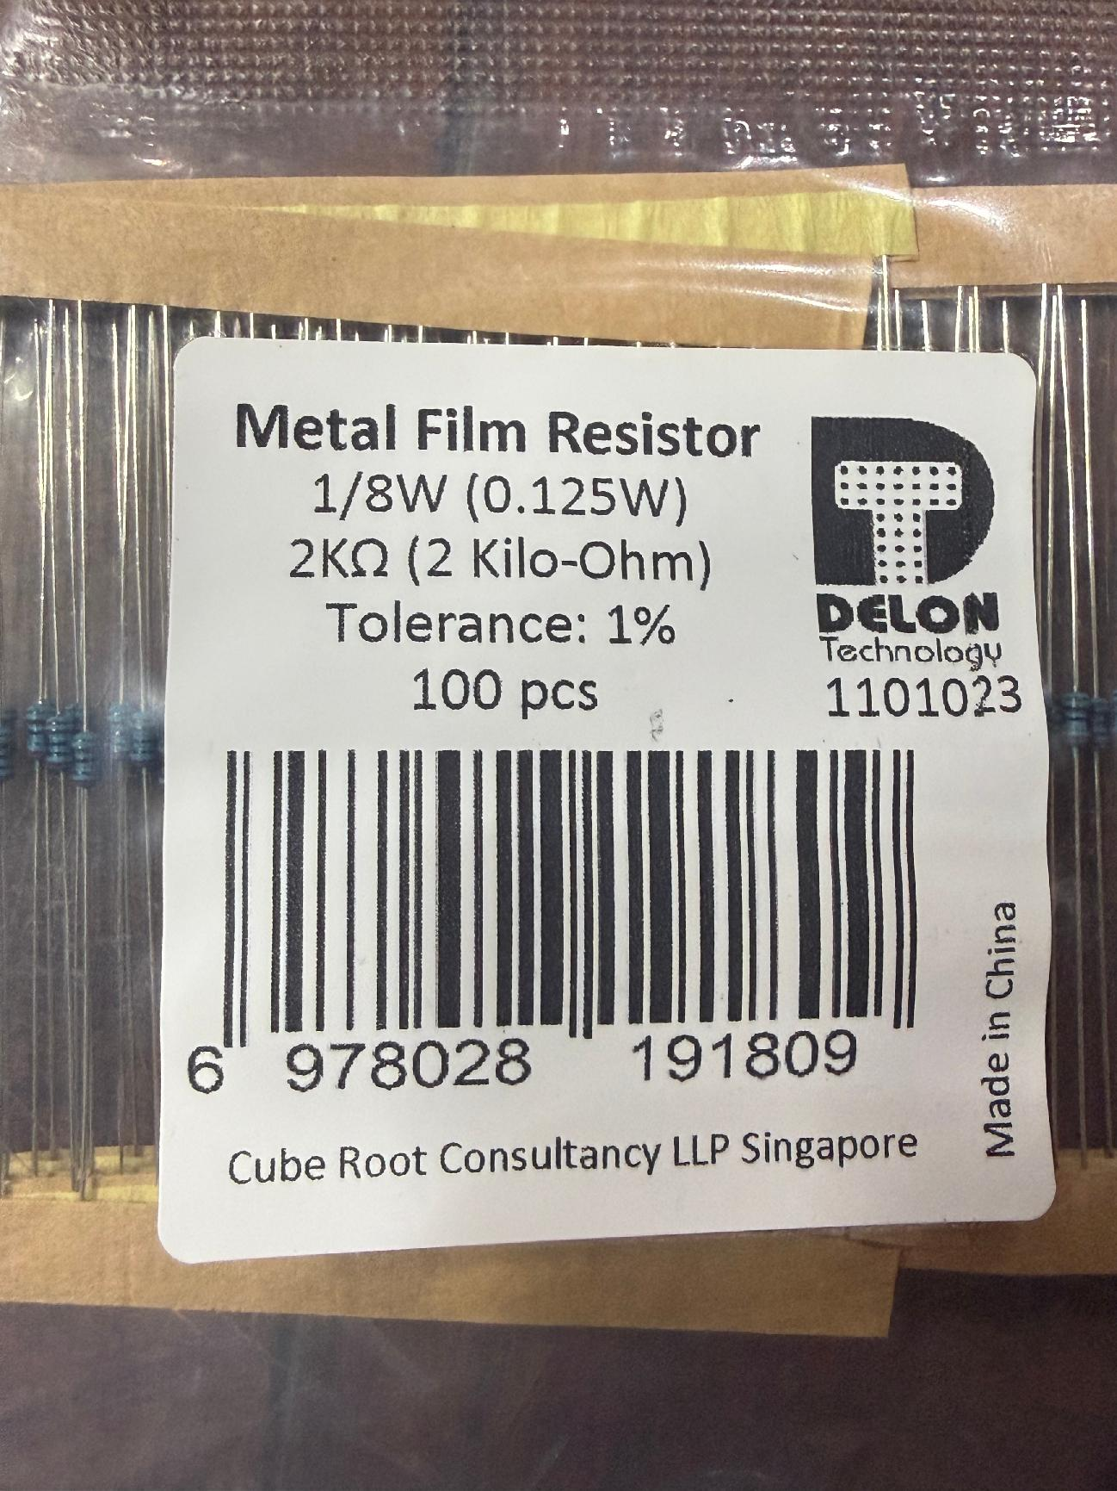
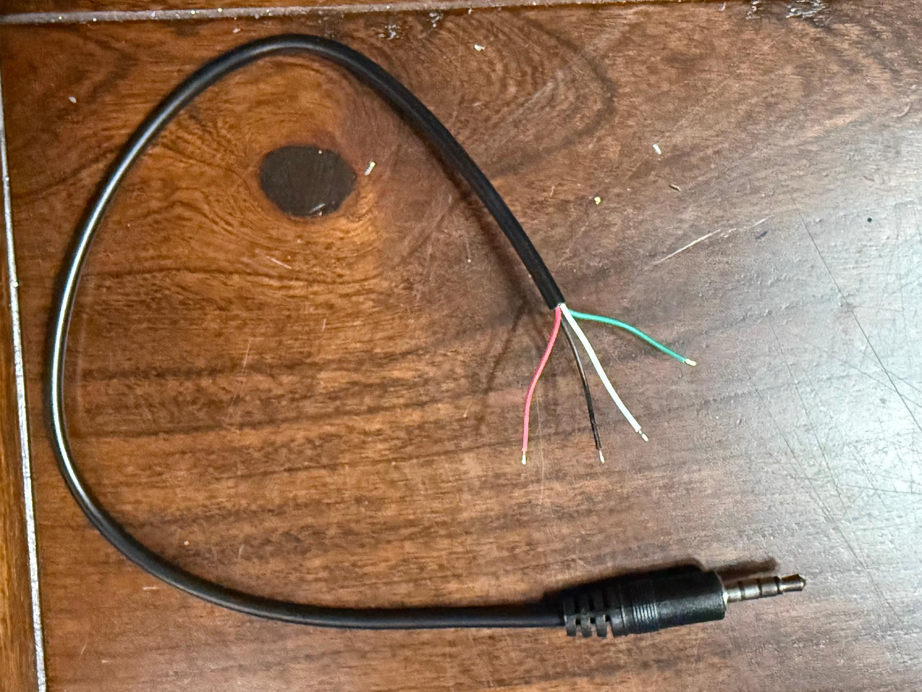
All the parts you need
ALLECIN 10uF 25V 5x11mm Electrolytic Capacitor 10 UF MFD 25 Volt 0.2x0.43in Aluminum Capacitors (Pack of 15):
Amazon.com: RIIEYOCA 4 Pack 3.5mm Male Plug to Bare Wire Stereo Audio Cable,1/8" TRRS 4 Pole Mono Male Plug to Open End Audio Cable
Delon Technology - 2kΩ (2 Kilo-Ohm) Resistor, 100 Pack, ±1%, 1/8W | Metal Film Resistor
$5.99
$4.99
$7.99

Slide 17
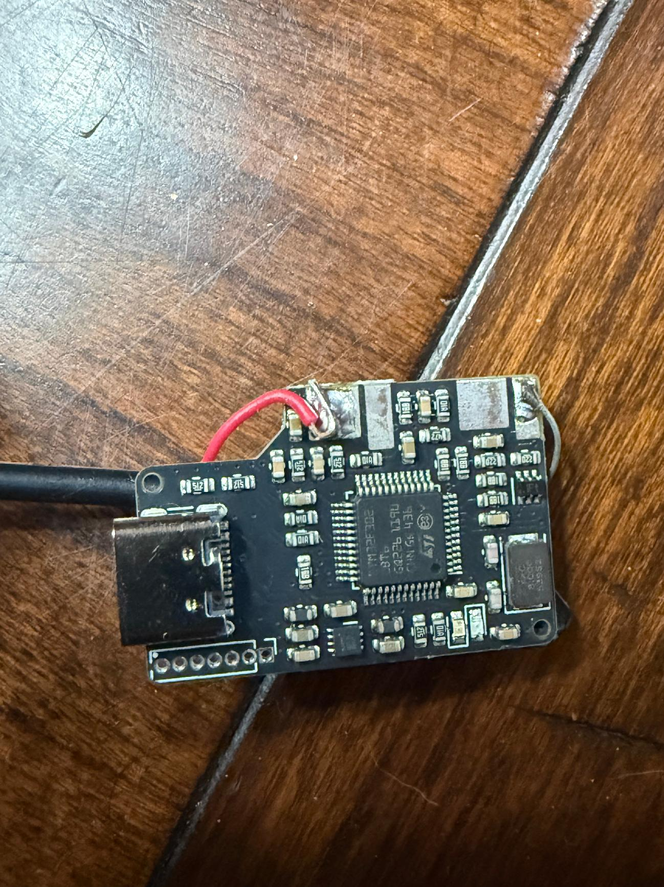
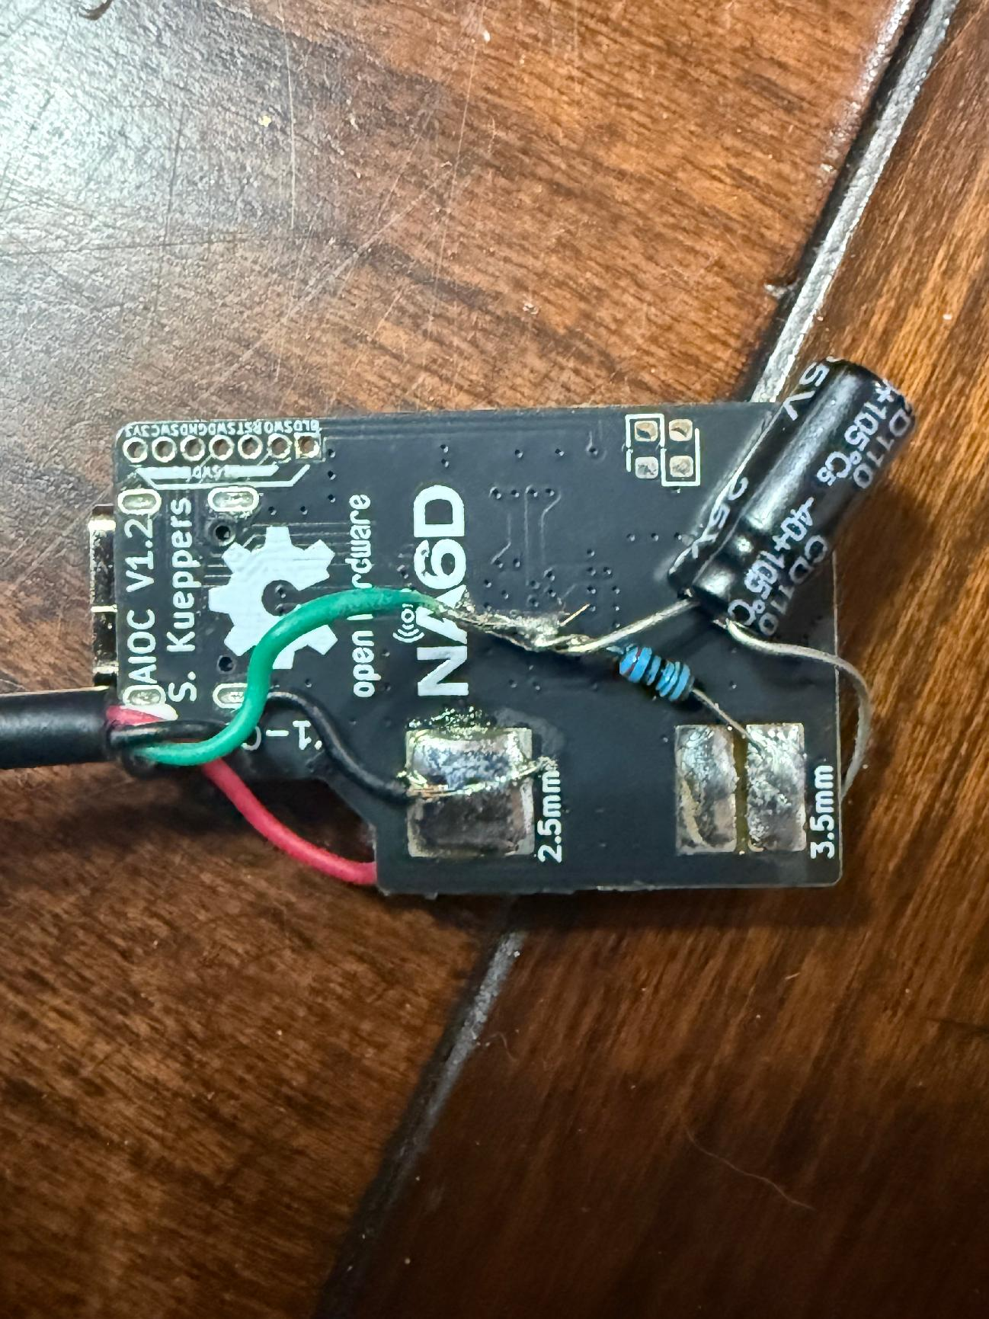
Solder connection pics
DIGIPI
6 / 12

Slide 18
Congrats!
Now you can
go make things
☺
DIGIPI
6 / 12

