Slide 1
OFF-GRID COMMUNICATION
Meshtastic, Meshcore,
And Mesh Radio
Open-source LoRa mesh networking for areas without infrastructure
By: N1TXN

Slide 2
OVERVIEW
What We'll Cover
01
Mesh Networking & Meshtastic
Foundations, how it works
02
Hardware & Devices
Heltec, T-Deck, RAK, T-Beam and the ecosystem
03
Integrations: ATAK & MQTT
Tactical awareness plugins and internet bridging
04
Meshtastic vs MeshCore
Routing philosophies and when to choose each
05
Licensed vs Unlicensed
Ham radio rules versus ISM-band operation
06
Use Cases, Trade-offs & Getting Started
Applications, strengths, and next steps
MESHTASTIC | Off-Grid Mesh Communication
2

Slide 3



FOUNDATIONS
What is Mesh Radio?
A mesh network is a decentralized topology where every node can relay data for others. Messages "hop" from device to device until they reach their destination — no central tower or internet required.
Self-Healing
Infrastructure-Free
Scalable Coverage
If one node drops out, traffic automatically finds another path.
Works in remote areas, disasters, or anywhere cellular is unavailable.
Each additional node extends the network. Range multiplies with hops.
MESHTASTIC | Off-Grid Mesh Communication
3

Slide 4
COMPARISON
Meshtastic vs MeshCore
Same LoRa hardware, different philosophies. Not interoperable.
Dimension
Meshtastic
MeshCore
Routing
Managed flooding — any node can relay
Source routing — only Repeaters relay
Max Hops
Default 3, hard ceiling 7
Up to 64 hops
Client Role
Clients relay by default
Companions never relay
Scalability
Best for ad-hoc / mobile groups
Better for dense / planned nets
Handheld Battery
Good
Better (no relay duty)
Community
Large, global, mature
Smaller, growing (EU strong)
License / Cost
Fully open-source (GPL), free
MIT firmware; some app features paid
Best For
Hiking, events, zero-config use
Fixed repeaters, city/region meshes
MESHTASTIC | Off-Grid Mesh Communication
10

Slide 5
THE PLATFORM
What is Meshtastic?
An open-source project that turns inexpensive LoRa radios into a long-range, off-grid communication platform.
LoRa-based
Long Range
Unlicensed ISM bands (915 MHz US, 868 MHz EU). No ham license required for most use.
Typical 1.25–3 mi; record of 205 mi under ideal conditions.
Decentralized
Low Power
No dedicated router. Every node can send, receive, and relay.
Days of battery life; solar-ready for fixed nodes.
Encrypted
App Connected
AES-256 channel encryption. Private channels with shared keys.
Pair via Bluetooth, Wi-Fi, or USB. Android, iOS, desktop.
MESHTASTIC | Off-Grid Mesh Communication
4

Slide 6
TECHNICAL OVERVIEW
How Meshtastic Works
1
2
3
4
Send
Broadcast
Relay
Deliver
App relays message to radio via Bluetooth, Wi-Fi, or serial.
Radio transmits LoRa packet. Retries up to 3× if needed.
Nodes check if seen before; if new, decrement hop & rebroadcast.
Destination receives message. Nodes store ~30 packets offline.
Managed Flooding
A node listens briefly before rebroadcasting. If another node has already relayed the packet, it stays silent. This reduces congestion while ensuring robust multi-hop delivery. Default hop limit is 3 (up to 7).
MESHTASTIC | Off-Grid Mesh Communication
5

Slide 7

TECHNICAL OVERVIEW
Packet Flow — Visual
900mHz
Bluetooth
NODE B
Possible
Relay
NODE A
Sender
900mHz
Phone App
Bluetooth
NODE D
Destination
App
900mHz
NODE C
Possible
Relay
Hops = 3
Managed Flooding
Hop Limit
Nodes listen briefly. If another node already rebroadcast, they stay silent — less airtime.
Each rebroadcast decrements the hop counter. At 0 the packet stops — default max is 3.
MESHTASTIC | Off-Grid Mesh Communication
6

Slide 8
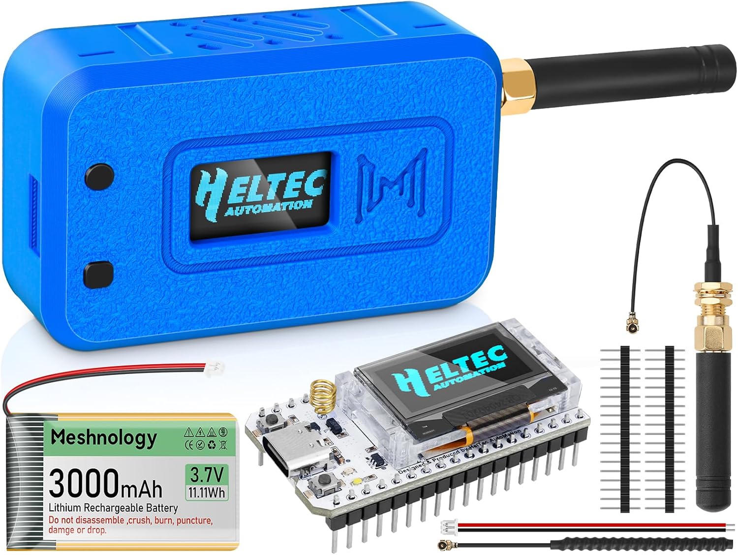
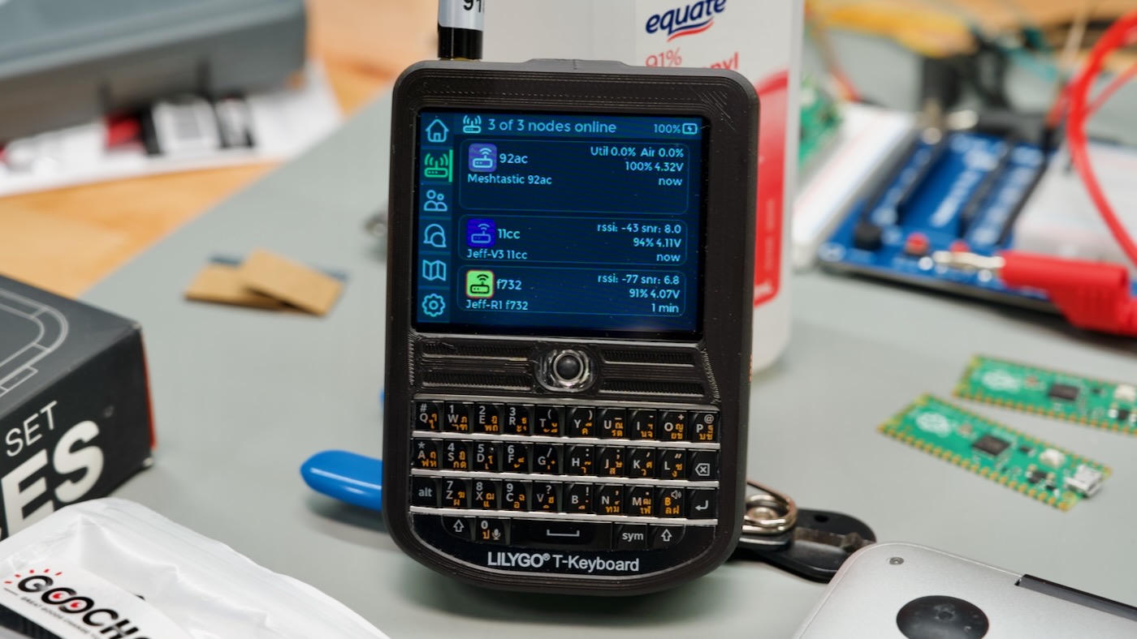
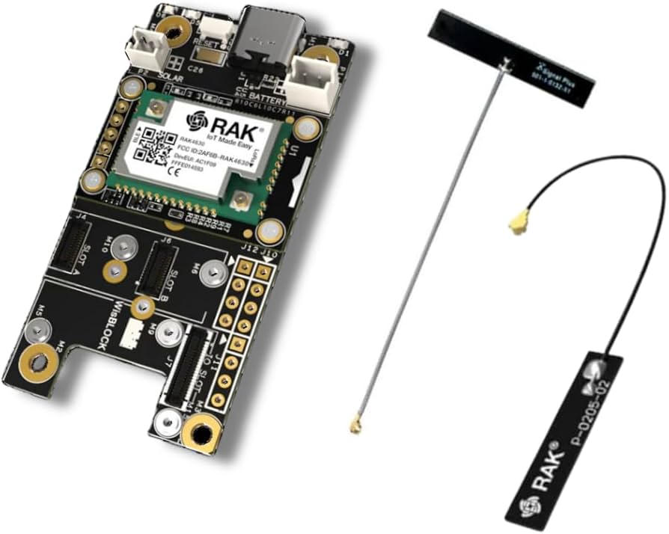
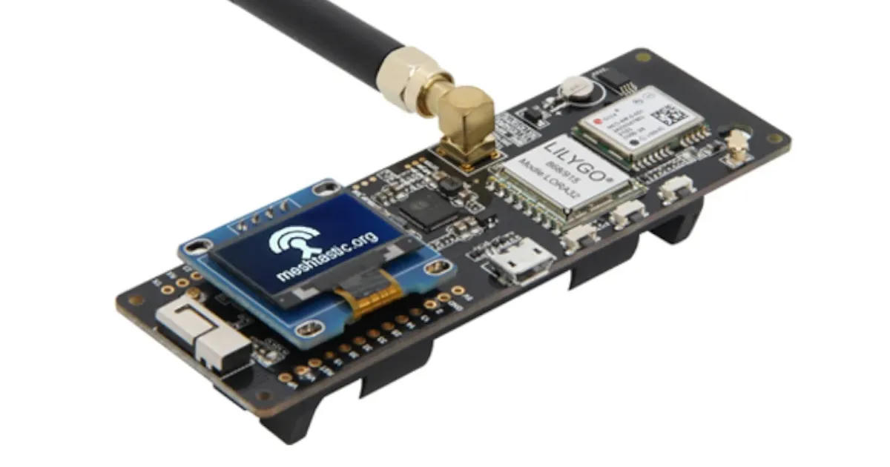
HARDWARE
Common Meshtastic Devices
Heltec V3/V4
LILYGO T-Deck
RAK WisBlock
LILYGO T-Beam
Budget entry
ESP32-S3 + SX1262
OLED · ~$20–30
Standalone unit
Screen + keyboard
No phone needed
Modular & solar-ready
nRF52 + SX1262
Best for repeaters
GPS tracker
ESP32 + SX1262
18650 battery slot
MESHTASTIC | Off-Grid Mesh Communication
7

Slide 9




INTEGRATIONS
ATAK / TAK Plugin
Meshtastic bridges tactical team awareness off-grid via the official ATAK plugin and TAK module.
Position Sharing (PLI)
GeoChat Bridging
Real-time location of team members appears on the ATAK map over the mesh — no cell or internet.
Chat messages and CoT(cursor on target) events flow between ATAK and the Meshtastic mesh network.
TAK / TAK_TRACKER Roles
Server Relay & Packages
Set device role to TAK (or TAK_TRACKER for GPS-only nodes) for optimized CoT packets.
Optional relay of CoT to TAK servers; mission packages can transfer over Short/Turbo.
Setup: Install Meshtastic Android app + matching ATAK plugin APK → set device role to TAK → keep Meshtastic app running in background → green icon in ATAK confirms link. Standalone BLE plugin also available.
MESHTASTIC | Off-Grid Mesh Communication
8

Slide 10


INTEGRATIONS
MQTT — Bridging Mesh to the Internet
MQTT lets an internet-connected gateway node forward mesh traffic to a broker, linking distant meshes and enabling maps, monitoring, and automation.
Local Mesh
Gateway Node
MQTT Broker
Remote Mesh
LoRa nodes talk
over radio
Wi-Fi / Ethernet
or phone proxy
mqtt.meshtastic.org
or private broker
Other gateways
inject traffic
Uplink / Downlink
Public Map & Monitoring
Privacy Controls
Per-channel: uplink sends mesh → broker; downlink injects broker → mesh. Both optional.
Position reporting feeds public maps. Integrate with Home Assistant, Node-RED, dashboards.
Encryption optional on MQTT path. Disable uplink on private channels. Client proxy via phone.
MESHTASTIC | Off-Grid Mesh Communication
9

Slide 11


REGULATORY DETAIL
Licensed Ham vs Unlicensed (ISM)
Meshtastic supports both modes. Choice affects power, encryption, identification, and legal rules.
Unlicensed (ISM / Part 15)
Licensed Amateur (Part 97)
Access & Rules
Access & Identification
• No license, exam, or registration required
• Anyone can buy hardware and operate
• Must accept interference; no exclusive rights
• Requires valid amateur radio license
• Must identify with callsign (long name)
• Subject to amateur band plans & rules
Power & Spectrum
Power & Spectrum
• US 915 MHz: max ~1 W EIRP (+30 dBm)
• EU 868 MHz: typically 25 mW + duty-cycle limits
• ISM bands only (no amateur allocations)
• Higher power allowed (class & band dependent)
• Can use amateur allocations (e.g. 70 cm)
• Power limits lifted when is_licensed = true
Encryption & Privacy
Encryption Restriction
• Full AES-256 channel encryption allowed
• Private channels with shared keys supported
• Encryption generally prohibited under Part 97
• Meshtastic Ham Mode disables crypto automatically
MESHTASTIC | Off-Grid Mesh Communication
11

Slide 12




CAPABILITIES
Key Features
Text Messaging
GPS Location
AES-256 Encryption
Group channels and direct messages across the mesh
Optional position sharing and node mapping
Channel-level encryption with shared keys
Excellent Battery Life
Device Roles
MQTT Bridge
Days of operation; solar options for fixed nodes
Client, Router, Repeater, Tracker, TAK…
Internet gateway for remote mesh access
MESHTASTIC | Off-Grid Mesh Communication
12

Slide 13






APPLICATIONS
Real-World Use Cases
Outdoor & Adventure
Community Mesh
Emergency Prep
Hiking, backpacking, skiing — stay in touch when cell disappears.
Neighborhood or event meshes for private off-grid chat.
Disaster response and grid-down coordination.
IoT & Sensors
Remote Infrastructure
Education
Telemetry and asset tracking over long distances.
Solar-powered fixed nodes for persistent coverage.
Learn radio, networking, and embedded systems.
MESHTASTIC | Off-Grid Mesh Communication
13

Slide 14


TRADE-OFFS
Advantages & Considerations
Strengths
Limitations
▸ No infrastructure or fees
▸ Low bandwidth (text / small data)
▸ Works when cellular is down
▸ Not real-time voice or video
▸ Very low cost of entry
▸ Range depends on terrain
▸ Open-source & community-driven
▸ Congestion in dense meshes
▸ Strong encryption (unlicensed)
▸ Learning curve for advanced config
▸ Long range with multi-hop
▸ Regulatory power/duty limits
▸ ATAK & MQTT integrations
▸ Not compatible with MeshCore
▸ Excellent battery efficiency
▸ Ham mode disables encryption
MESHTASTIC | Off-Grid Mesh Communication
14

Slide 15
NEXT STEPS
Getting Started
1
Choose Hardware
Heltec, T-Deck, RAK, T-Beam… Prefer SX126x radios.
2
Flash Firmware
Web flasher. Set region. Choose Meshtastic or MeshCore.
3
Install App
Android / iOS Meshtastic app. Desktop CLI available.
4
Configure
Pair BT. Create channel. Set role (incl. TAK). Enable MQTT if desired.
5
Join / Integrate
Message the mesh. Optionally install ATAK plugin or MQTT gateway.
MESHTASTIC | Off-Grid Mesh Communication
15

Slide 16
Resources & Community
Meshtastic
MeshCore
meshtastic.org
Docs · Discord · GitHub
ATAK Plugin · MQTT guide
meshcore.co.uk
Docs · Community maps
Web flasher available
Same hardware can run either firmware. ATAK and MQTT extend Meshtastic for tactical and internet use.
Build resilient, infrastructure-free communication — one node at a time.

