Slide 1
WINLINK
HOW TO START

Slide 2
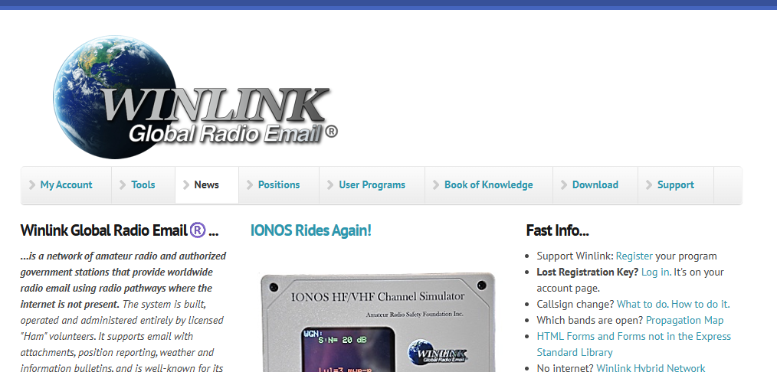
WINLINK.ORG
START HERE

Slide 3
THIS IS WHERE TO GO TO OBTAIN THE WINLINK PROGRAMS FOR YOUR INSTALL

Slide 4
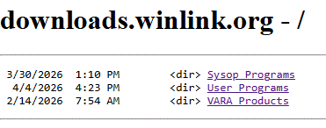

Slide 5
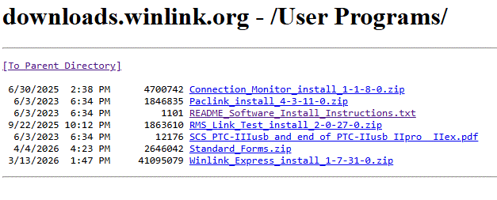

Slide 6
DOWNLOAD AND INSTALL FIRST

Slide 7
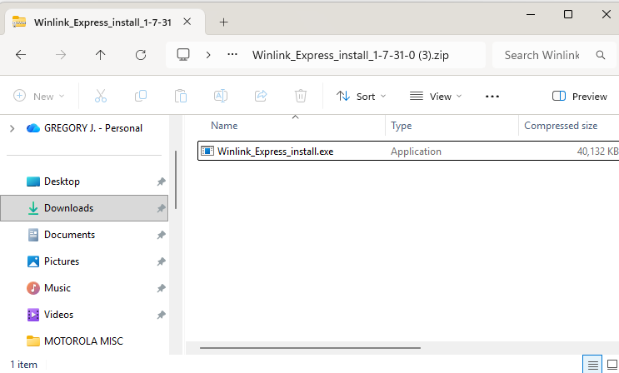

Slide 9
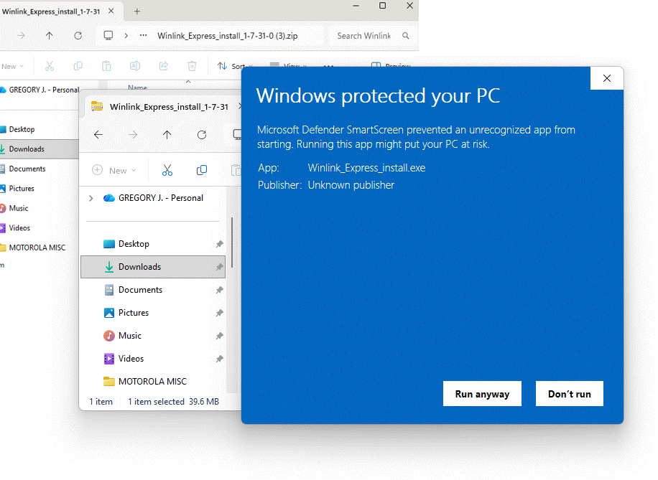
YOU MAY GET THIS POP-UP YOU WILL NEED TO RUN IT TO INSTALL WINLINK

Slide 10
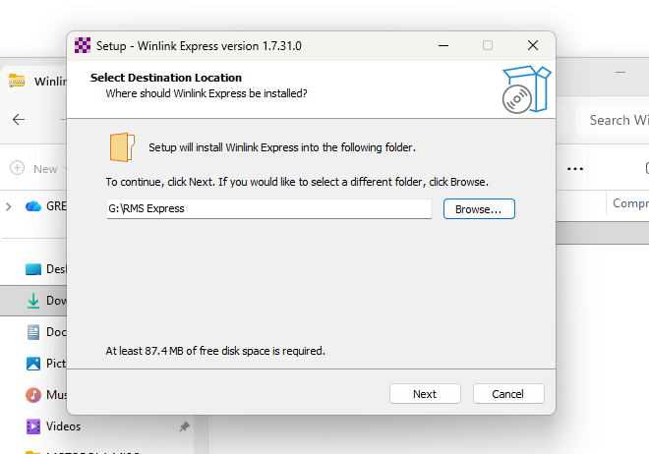
CHOOSE WHERE YOU WANT TO INSTALL THE WINLINK RMS EXPRESS PROGRAM ON YOUR COMPUTER.
PROCEED WITH THE INSTALLATION AND FOLLOW “ALL” INSTRUCTIONS.

Slide 11
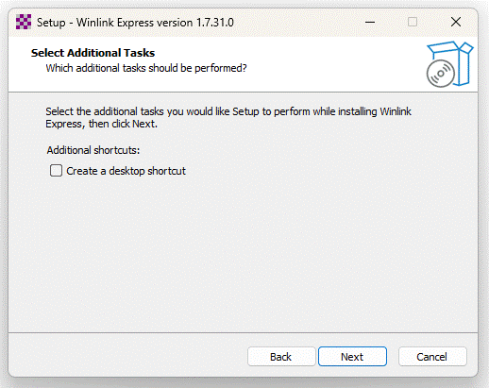
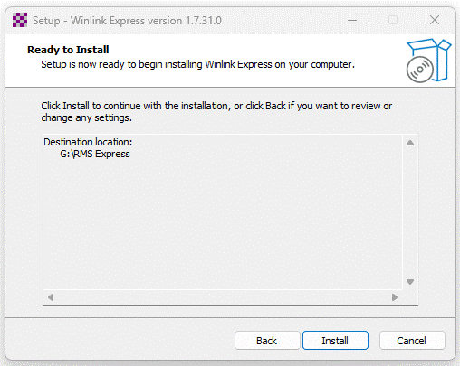

Slide 12
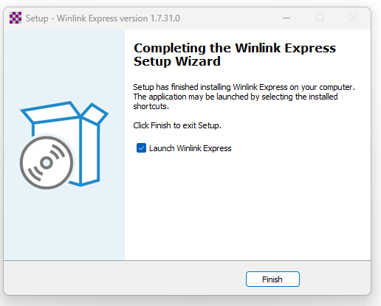
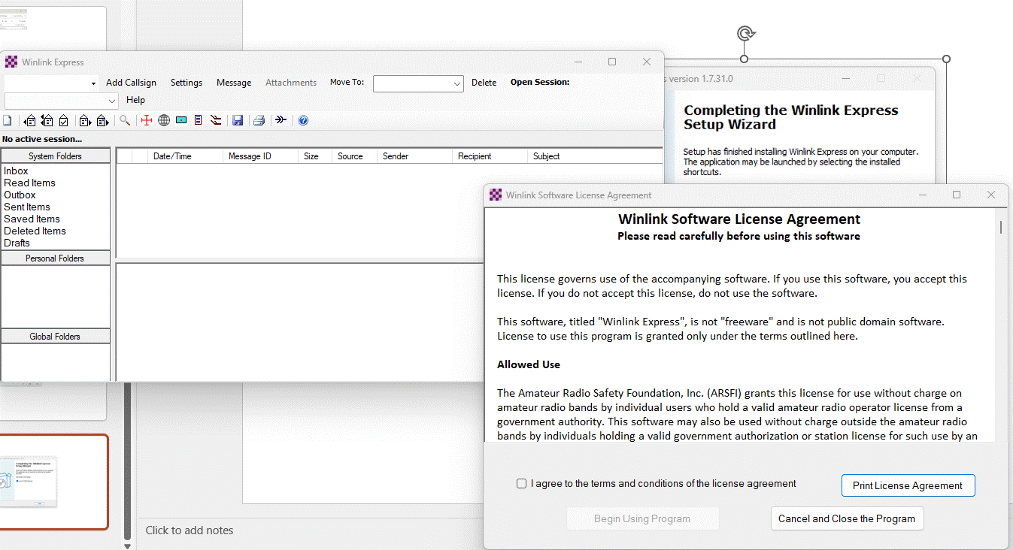

Slide 13
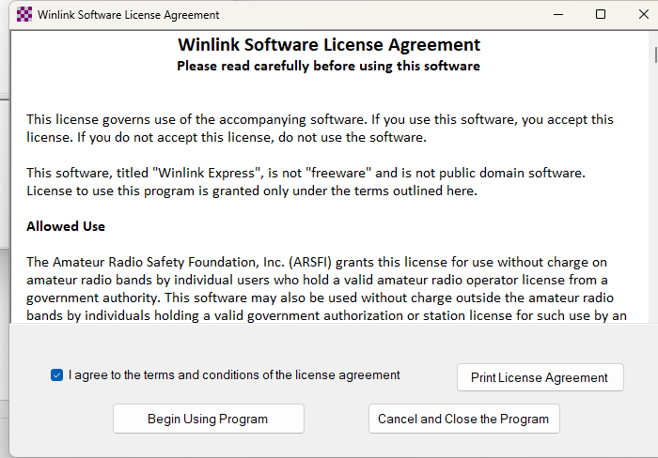
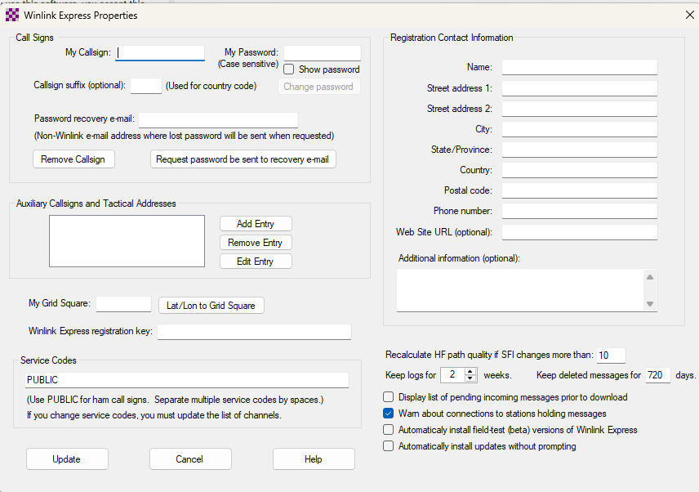

Slide 14
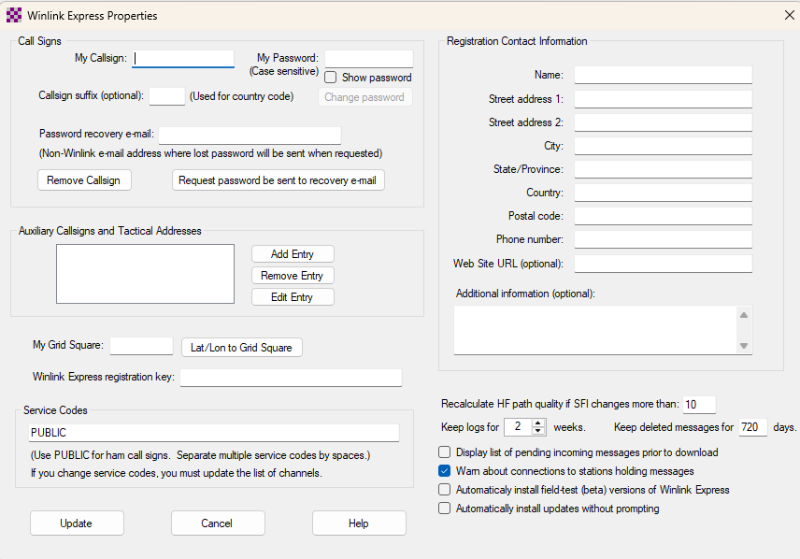

Slide 15
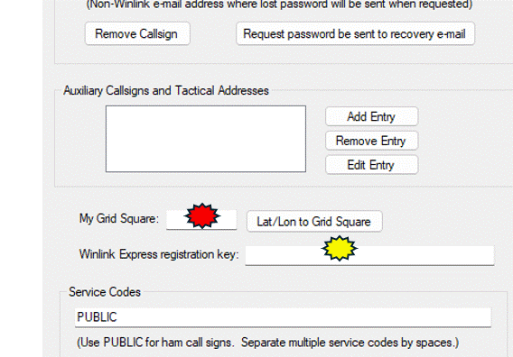
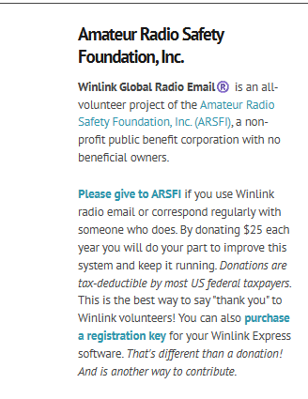

Slide 16
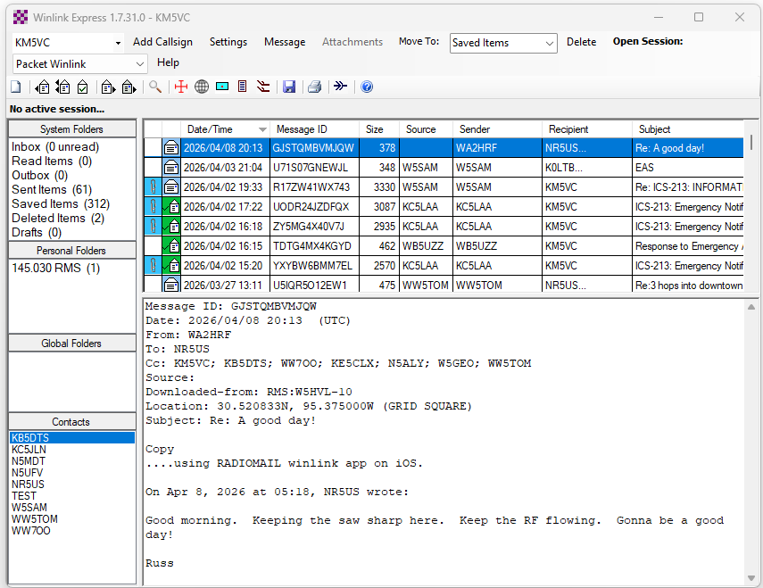
EXAMPLE WINLINK MAIN WINDOW

Slide 17
The previous slides were created to assist in your WINLINK adventure.
There are many steps you must complete to get your particular instance of WINLINK up and running.
You will need to set up your particular radios for use with this program and there are as many different ways to do so as there are different radios.
It will be time intensive, frustrating, and exhausting, but in the end, you will enjoy many hours utilizing this form of COMMUNICATIONS.

Slide 18
QUESTIONS:…………………….
I’m stuck, what do I do?
Where can I find information on____________?
Who can I call?
I broke it, what now?
I forgot my password HELP?
How do I create a new message?
How do I post that message so I can transmit it out?
And so many more questions and problems how do I get help?

Slide 19
ANSWERS:……………….
Start with considering the various members of this organization, WCARG, that may be utilizing WINLINK on a daily basis.
Contact some of these members that are participating in the local county ARES organization.
Contact some of these members that are participating in the STATE RACES organization.
Refer to the WCARG website and submit your questions via the contact section. WWW.WCARG.ORG

